Slide 1



INTERNSHIP REVIEW
BY: Jahnavi Dande
UCE2022519
TY Comp B
Mentors:
Yash Palan
PhD Researcher,
Goethe University, Frankfurt-Am-Main
Dr. Nitin Palan
Associate Professor,
Cummins College of Engineering for Women, Pune

Slide 2



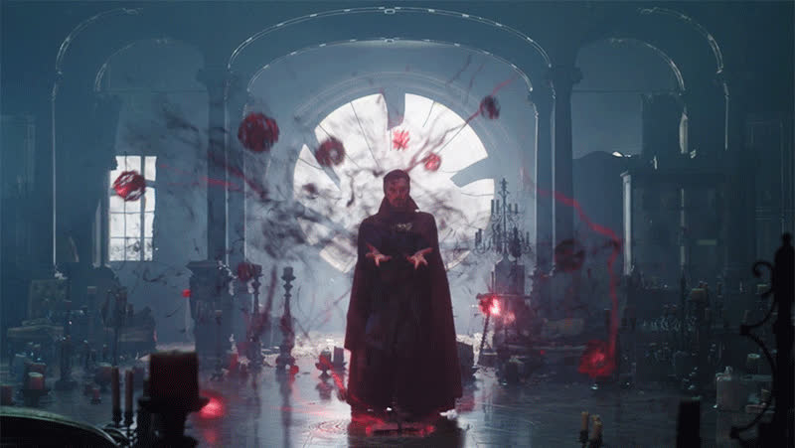
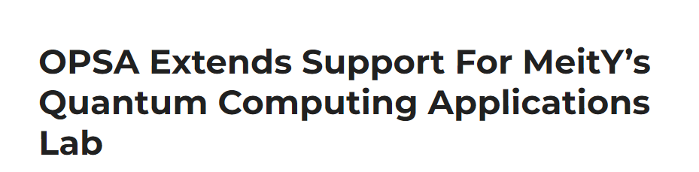
MOTIVATION
WHY QUANTUM MECHANICS?

Slide 3



WHAT IS QUANTUM MECHANICS?
Particles smaller than atoms behave
differently!!
Classical Mechanics : Failed!
Quantum Mechanics
State Space
Schrodinger
Evolution
3 postulates
Particles <= atoms
Measurement

Slide 4




POSTULATE 1: STATE SPACE
Associated with any isolated physical system is a Hilbert Space known as a state space of the system. This system is described by its state vector, which is a unit vector in the state space.
Hilbert Space?
Vector Space
Inner Product
Vector Space?
Collection of elements : Vectors
|u⟩
|v⟩
Added Together
|u+v⟩
Multiplied by scalar
2 x
|u⟩

Slide 5
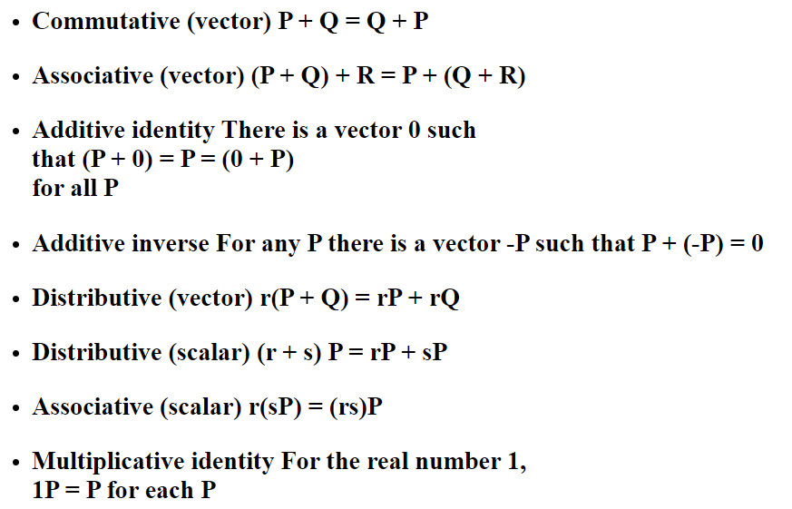

POSTULATE 1: STATE SPACE
Properties:
Commutative
|u⟩
|v⟩
|u+v⟩
|v⟩
|u⟩
Associative
|w⟩
|v⟩
|u⟩
|u+w+v⟩
|u+w⟩
|v⟩
|u+w+v⟩
|u⟩
|w+v⟩
|u+w+v⟩

Slide 6

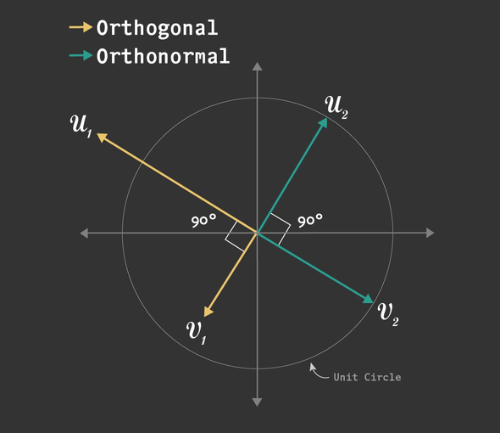


POSTULATE 1: STATE SPACE
Inner Product?
Input(Vector, Vector)
Output(Complex Number)
Special cases:
Inner product = 1 => Unit Vector
2. Inner product = 0 => Orthogonal Vectors
Reference:
https://www.learndatasci.com/glossary/orthogonal-and-orthonormal-vectors/

Slide 7
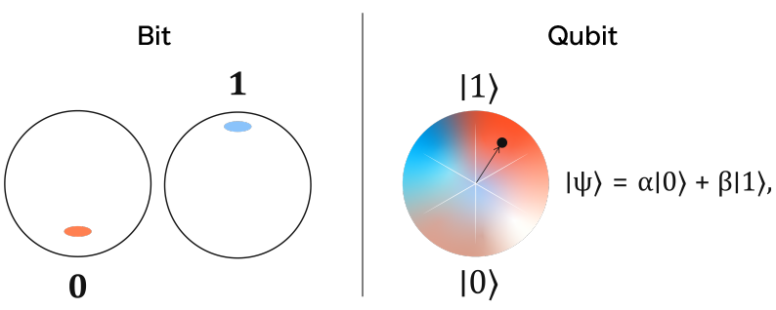



POSTULATE 1: STATE SPACE
Example : Qubit
State Space : 2D
Orthonormal Basis:
|0⟩ and |1⟩
Arbitrary State Vector:
|ψ⟩ = a|0⟩ + b|1⟩
Reference:
https://www.qnulabs.com/quantum-101-qubit/
Unit vector :
=> Normalization condition
Superpositions:
Amplitude
State

Slide 8
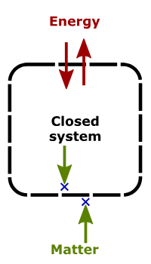




POSTULATE 2: EVOLUTION (DISCRETE TIMES)
The evolution of a closed quantum system is described by a unitary transformation.
|ψ(t2)⟩ = U(t1, t2) |ψ(t1)⟩
State at time t2
State at time t1
Unitary Operators?
=
{
Linear
Operators
Hermitian Operators?
Matrix representation:

Slide 9




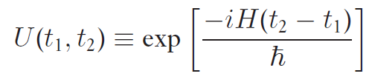
POSTULATE 2': EVOLUTION (CONTINUOUS TIME)
The time evolution of the state of a closed quantum system is described by the Schrodinger equation.
{
Time Dependent Schrodinger Equation (TDSE)
Planck’s constant
Hamiltonian
(Fixed Hermitian Operator)
Postulate 2
Postulate 2 ‘
Where

Slide 10
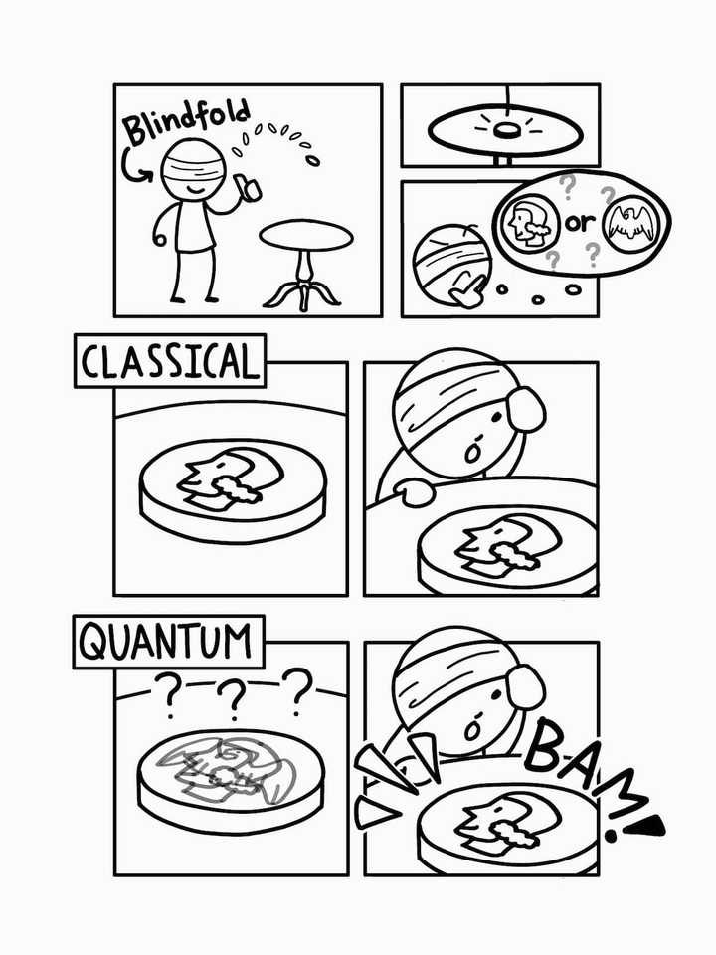


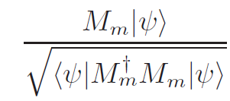
POSTULATE 3: MEASUREMENT
Quantum measurements are described by a collection {Mm} of measurement operators.
State before measurement:
Probability of result m after measurement:
State of the system after the measurement:

Slide 11
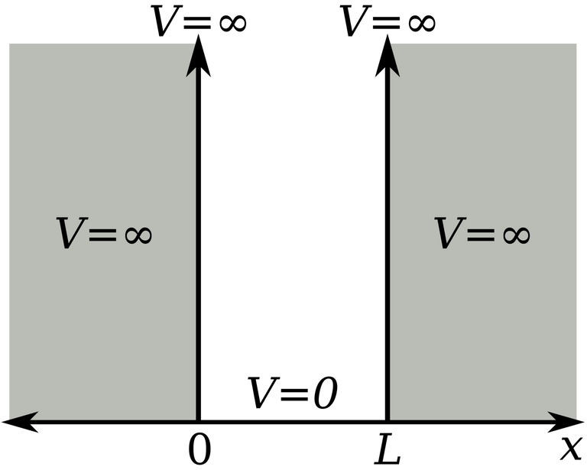
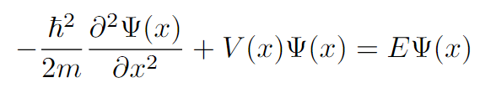





EXAMPLES OF A QUANTUM SYSTEM
A. INFINITE SQUARE WELL
The Time independent Schrodinger equation ( TISE ) is
Ansatz:
Boundary Conditions:
Reference: https://physics.stackexchange.com/questions/544066/imaginary-constant-in-simplification-of-the-infinite-square-well-problem

Slide 12
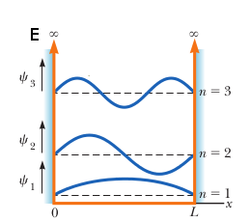

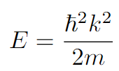

EXAMPLES OF A QUANTUM SYSTEM
A. INFINITE SQUARE WELL : Energy
Wavefunction = ?
Ansatz:
Substituting this in the TISE:
Since
:
Reference:
https://physics.stackexchange.com/questions/316668/predicting-the-value-of-n-for-the-energy-of-a-wavefunction-in-the-infinite-squ

Slide 13



EXAMPLES OF A QUANTUM SYSTEM
B. HARMONIC OSCILLATOR
For harmonic oscillators:
The TISE:
Hard to solve analytically!
Reference:
https://en.wikipedia.org/wiki/Harmonic_oscillator

Slide 14
EXAMPLES OF A QUANTUM SYSTEM
B. HARMONIC OSCILLATOR
Technique: Imaginary Time Evolution
Input: Wavefunction
Output: Ground state of the Hamiltonian
Idea: Substitute
it = τ
In TDSE:

Slide 15
HARMONIC OSCILLATOR
Ground State:
Ψ(τ) = ∑[ (ai) e^(-E τ)(φi)]
The TDSE is:
(a0) e^(-(E0) τ)(φ0) + (a1) e^(-(E1) τ)(φ1)...
e^(-(E0) τ) [(a0)(φ0) + (a1) e^(-(E1-E0) τ)(φ1)...]
This equation converges to give us ground state.
Tech Stack:
Code : Python (Scipy.integrate: solve_ivp)
Plots: Matplotlib

Slide 16
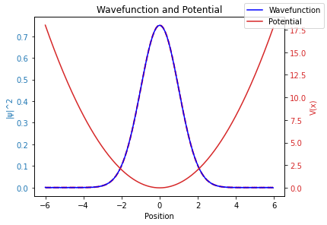
HARMONIC OSCILLATOR
Ground state:

Slide 17

HARMONIC OSCILLATOR
First Excited State: Lowest Lying Energy State
Idea: Orthogonal Vectors
Ψ(τ) = ∑[ (ai) e^(-E τ)|φi⟩]
The TDSE is:
Now,
⟨φ0|ψ(τ)⟩ = (a0) e^(-(E0) τ)⟨φ0|φ0⟩ + (a1) e^(-(E1) τ)⟨φ0|φ1⟩...
⟨φi|φj⟩ = a0 (i j)
(Orthogonal Vectors)
⟨φ0|ψit⟩ = a0
Thus,
|ψ(τ)⟩ - a0|φ0⟩ = (a1) e^(-(E1) τ)|φ1⟩ + (a2) e^(-(E2) τ)|φ2⟩ ...

Slide 18
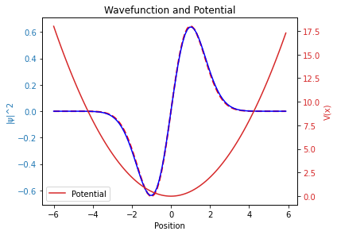
HARMONIC OSCILLATOR
2. First Excited State:

Slide 19
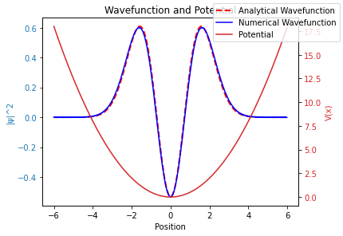
HARMONIC OSCILLATOR
3. Second Excited State:

Slide 20
REFERENCES
BOOKS:
Quantum Computation and Quantum Information (10th anniversary edition) - Michael A. Nielsen & Isaac L. Chuang
Introduction to Quantum Mechanics (3rd edition) - David J. Griffiths & Darrell F. Schroeter
INTERNET RESOURCES:
Overleaf - Online LaTeX editor
SciPy - Scientific Python

Slide 21

THANK YOU

